Slide 1
About this PowerPoint
COTA Tasmania has developed this PowerPoint as a starting point for council staff to present information about Liveable Communities to council and community.
Information presented in this PowerPoint has been sourced from the Liveable Communities Grants Program Toolkit.
This PowerPoint provides only a framework for presentation and should be adapted and developed to specific audiences and needs. Please change the template and information accordingly.
For more information, please contact COTA Tasmania on 6231 3265 or email RosalindH@cotatas.org.au.

Slide 2
Liveable Communities
The what, why, who and how

Slide 3
What is a Liveable Community?
A liveable community is one that is safe and secure, has affordable and appropriate housing and transportation options, and supportive community features and services.
Once in place, those resources enhance personal independence; allow residents to age in place; and foster residents’ engagement in the community’s civic, economic, and social life¹.
Notes:
Refer to What is a Liveable Community factsheet in Toolkit
Liveable communities, also known as age-friendly communities, support people of all ages, backgrounds and circumstances to engage and participate in community life, and live safe and healthy lives.
They provide safe, affordable and high quality choice in transportation, housing and services.
They adapt structures and services to allow people of all abilities and ages to enjoy services and community features, live where they choose and increase their ability to access destinations.
They recognise and act on issues such as health, wellness, safety, work, education, environment and social engagement to prevent or delay the onset of disease and enable all members of the community to live their best lives the way they want.

Slide 4
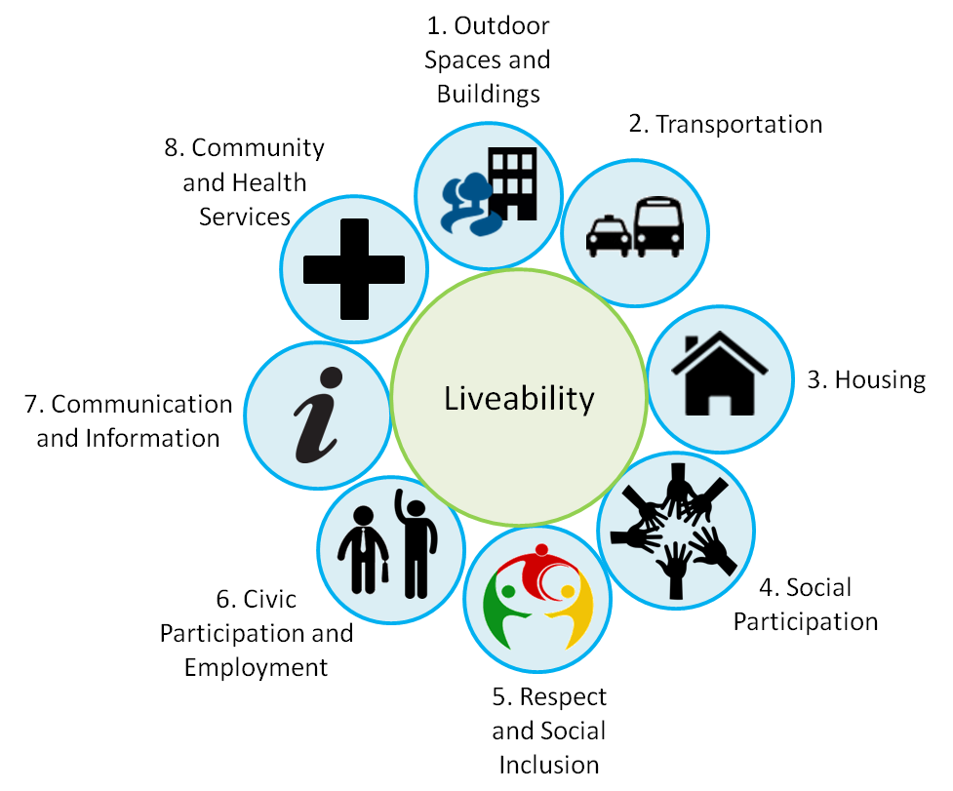
The World Health Organisation’s 8 domains of liveability²
Notes:
The 8 domains of liveability identify areas of the community that affect quality of life. They provide a framework to help address liveability in your community.

Slide 5
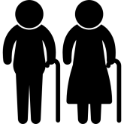
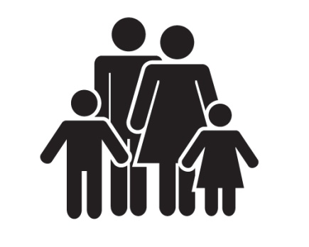
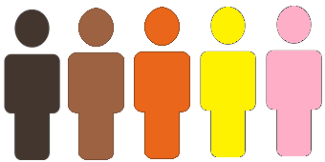
Liveable Communities benefit everyone
Promote healthy, supported and inclusive living
Allow people of all abilities, backgrounds, circumstances and ages to access and enjoy services and community features
Foster respect and inclusion across the whole of community
Notes:
Older people are healthy and engaged, able to age in their homes safely, access services easily and are respected and valued
Families and children are safe, supported, active and able to access services and businesses easily
People with disabilities can access services, remain independent and are valued and respected
People from culturally diverse backgrounds are respected, valued, able to access services easily and safely, and feel supported and included
People on low income are supported and able to access safe, affordable and high quality services

Slide 6
Population ageing is a global trend
Healthcare is improving and fertility rates are decreasing
An ageing population presents some challenges for community, but also a great many opportunities
The proportion of Australia’s population over 65 years old has increased from 14.0% in 2011 to 15.7% in 2016^{3,4}
Communities must be prepared to support people of all physical abilities and backgrounds to live independent and meaningful lives at every stage of life, now and into the future.
Notes:
Australians are living with less disability for longer, but age-related decline is inevitable, though it occurs much later than previous generations

Slide 7
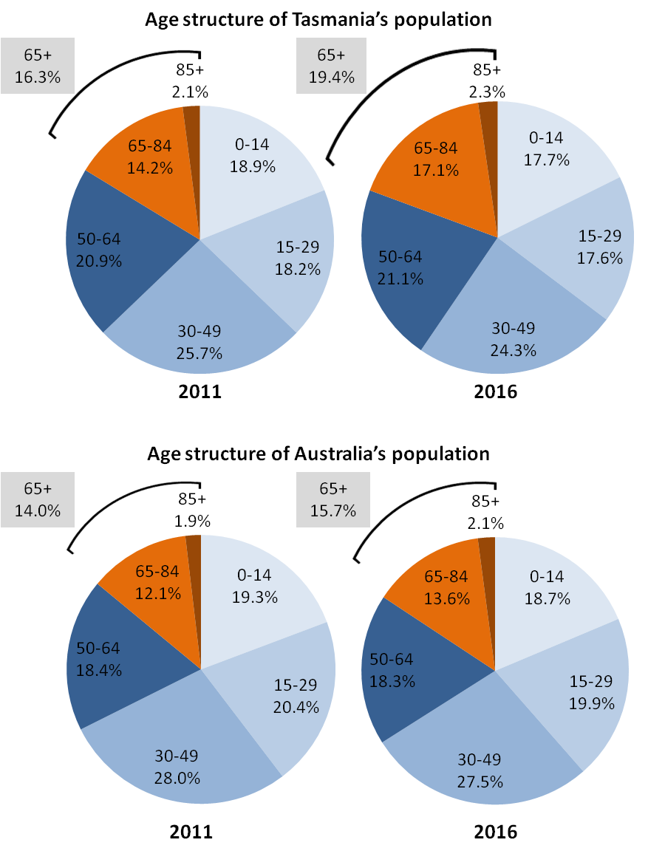
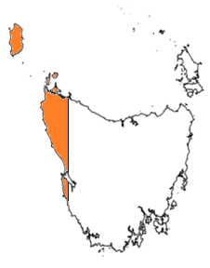
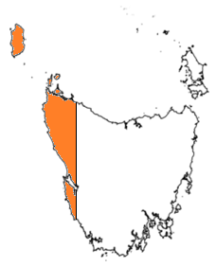
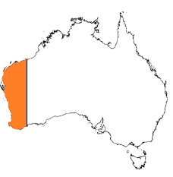
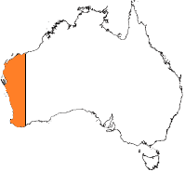
Tasmania has the oldest population in Australia^{3,4}
The proportion of Tasmania’s population aged over 65 years increased by 3.4% from 2011 to 2016, compared to a national increase of 1.7%.
65 years+ = 16.3%
65 years+ = 19.4%
Median age: 40
Median age: 42
2011
2016
65 years+ = 14.0%
65 years+ = 15.7%
Median age: 37
Median age: 38
Notes:
Tasmania’s population is ageing faster than the Australian average.

Slide 8
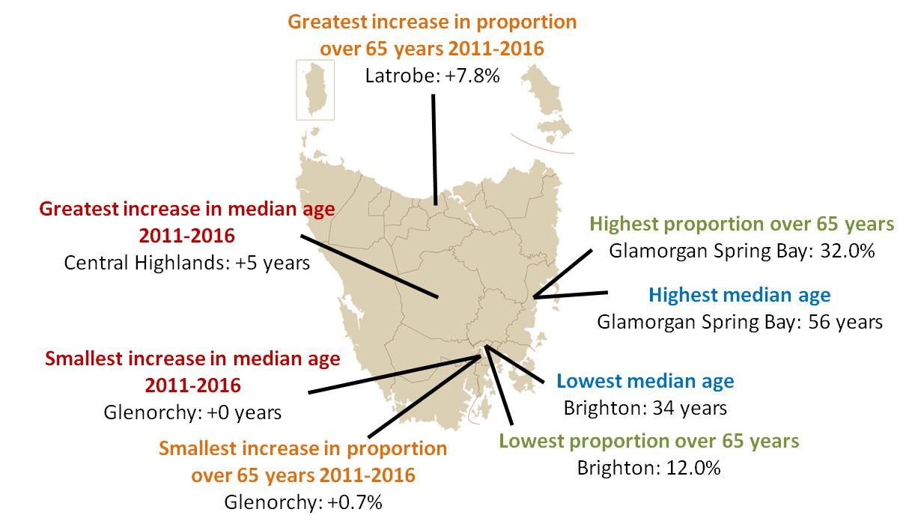
Populations in every LGA are ageing

Slide 9
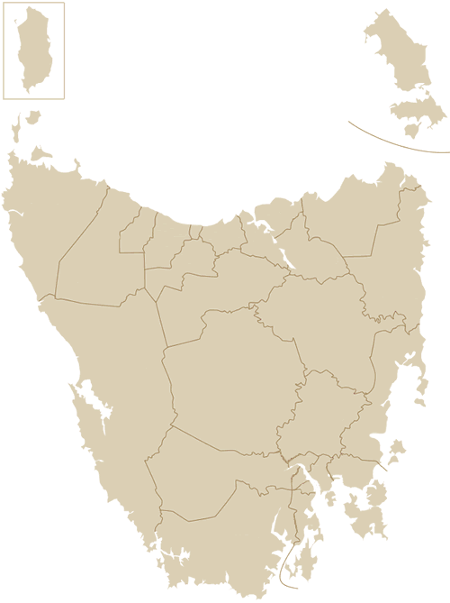
‘Your LGA statistics’
The median age of LGA increased from __ years in 2011 to __ years in 2016.
The proportion of LGAs population aged over 65 years increased from __% in 2011 to __% in 2016.
EXAMPLE
Notes:
Refer to Tasmania’s ageing population – Statistics factsheet

Slide 10
How do we become a Liveable Community⁵?
Engage with older people in your community to identify its liveability
Establish a Liveability (or Age-Friendly) Committee
Have a liveability resolution passed by your local government
Conduct a liveability assessment of your community
Develop a community profile
Undertake a consultation process
Complete the assessment
Publish the assessment and share results
Develop and implement an action plan
Notes:
Refer to How do we become a Liveable Community factsheet
1. Community engagement with people from a range of backgrounds must be central to developing and implementing a Liveable Community that can effectively address barriers and issues to liveability.
2. Liveability Committee must be council driven and engage a broad range of people from community, business and government who are dedicated to planning, co-ordinating, promoting and realised a Liveable Community for the long term
3. A liveability resolution indicates and formalises the community and councils commitment to becoming a Liveable community
4. Liveability assessment will identify how liveable the community is and what needs to change. As part of this it is useful to:
Develop a community profile – what your unique community looks like now, geographically, demographically, socially and economically
Undertake a consultation process – talk to members of your community to identify liveability barriers and opportunities
Complete the assessment – complete an assessment of your community using resources and checklists, following the WHO 8 domains of liveability
Publish the assessment and share results – raise awareness of community’s liveability, review resources and mobilise additional support
5. Develop an action plan with the Liveability Committee and key community stakeholders, detailing and monitoring specific and achievable actions to improve community liveability. Share this with the community and welcome feedback

Slide 11
Community engagement is essential
Engagement benefits those who participate, council and the community at large
Use a range of methods to engage the whole of community
Don’t assume everyone is online
Always provide feedback
Expect to learn something new when engaging with your community
Notes:
Refer to Communicating and engaging with your community and Digital Technology and Older Tasmanians factsheets
Community engagement is essential for development and implementation
Engage a diverse group of the community to effectively identify and address whole-of-community issues
Who: community groups, ATSI, CALD, vision or hearing impaired, People with health or mobility issues; People with low socio-economic status and those living in poverty; People with poor literacy and numeracy; People who are socially isolated due to physical or cognitive impairment, loss of social connections, or who do not know how or where to access services.
Careful planning is essential
Methods: Use a range of methods to engage different personalities, skills, motivations, mobility's and backgrounds
Need to take time, cost and resources into consideration when planning consultation methods.
Focus groups; Surveys; Art and creativity; Mapping; Web-based engagement.

Slide 12
10 simple ways to improve community liveability
Remove ageist language and imagery
Support existing community groups
Improve your community’s walkability
Foster intergenerational relationships
Provide service, event and activity information
Improve workplace attitudes
Prevent illegal parking in disabled parking spots
Raise awareness about community issues
Host events to talk to members of the community
Work with other councils
Notes:
Refer to 10 easy ways to improve your community’s liveability document

Slide 13
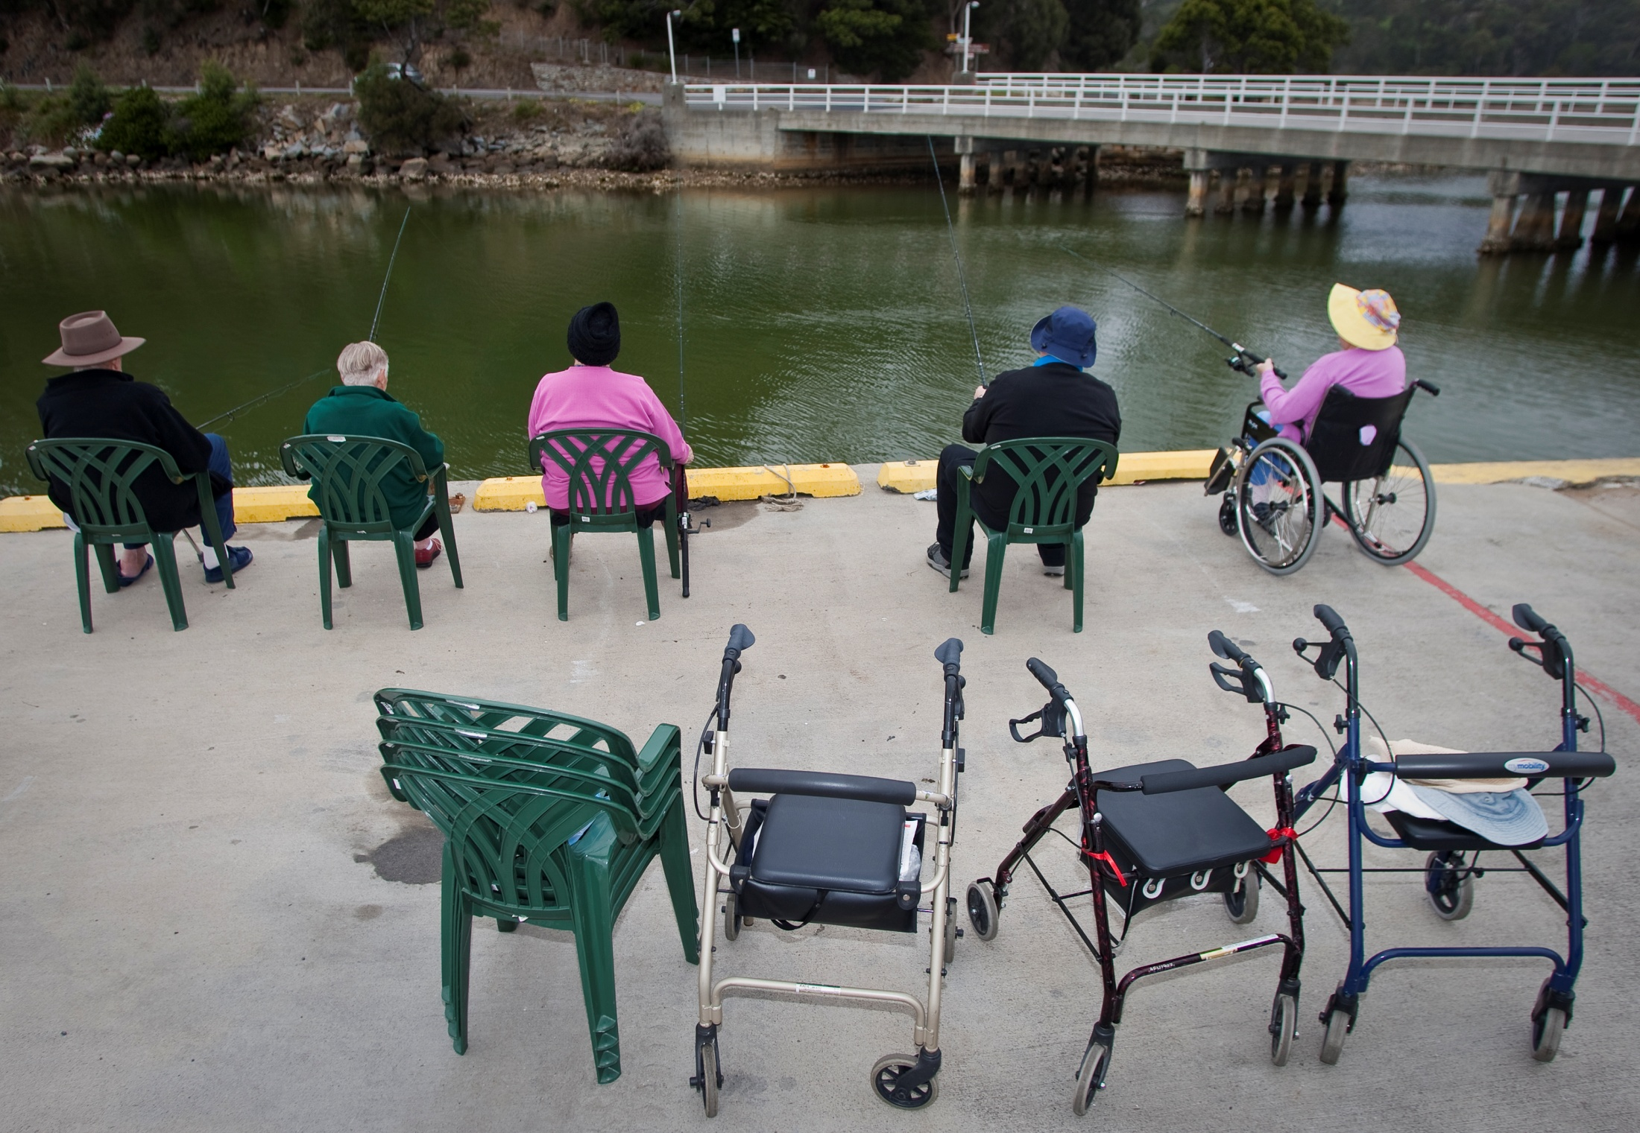
5 large ways to improve community liveability
Ensure community-wide disability access
Install traffic calming measures
Adopt universal design policies
Work with service providers of home care and support
Promote and support liveable businesses
Notes:
Refer to 5 large scale ways to improve your community’s liveability document

Slide 14
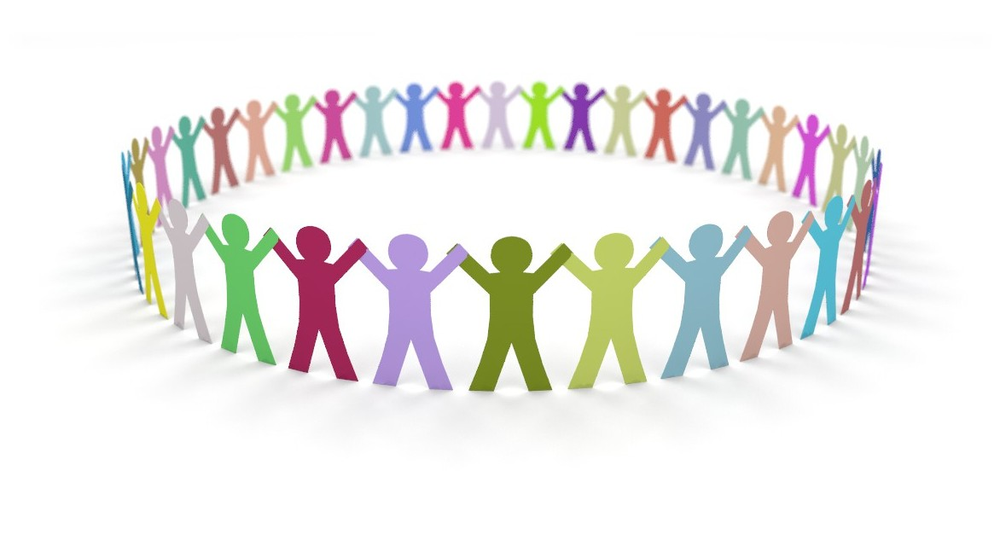
Where to from here?
Be inspired by models of Liveable Communities
Look at what international, Australian and Tasmanian communities are doing
Investigate funding and grants
Liveable Communities Grants program 2017-18
Australian Government Grant Connect
DPAC Grant programs
State Growth Grants
Tasmanian Community Fund

Slide 15
Liveable Communities Grants Program Toolkit
Tasmania’s ageing population - Statistics
What is a Liveable Community?
How do we become a Liveable Community?
Communicating and engaging with your community
Digital technology and older Tasmanians
10 easy ways to improve your community’s liveability
5 large scale ways to improve your community’s liveability
Liveable Community resources
Developed by Council on the Ageing (COTA) Tasmania

Slide 16
References
1. AARP Livable Communities: www.aarp.org/livable-communities
2. WHO Age-friendly Cities: A Guide: www.who.int/ageing/age_friendly_cities_guide/en
3. Australian Bureau of Statistics: 2016 Census QuickStats Tasmania
4. Australian Bureau of Statistics: 2011 Census QuickStats Tasmania
5. Building Age-Friendly Communities: A guide for local action, Alberta Government: www.seniors-housing.alberta.ca/documents/AgeFriendly-Guide-2012.pdf

